Slide 1
rCARI CARI Analysis-Iraq
On behalf of :
Alirah Weyori & Nicole WU (RAM-N)

Slide 2
Background
Traditional food security data is collected as face-to-face for micro/macro level analysis
In recent times face-to-face data collection restricted – limited access
Data gap
Negative impact for program design and implementation
WFP developed a novel methodology-remote CARI (rCARI)

Slide 3
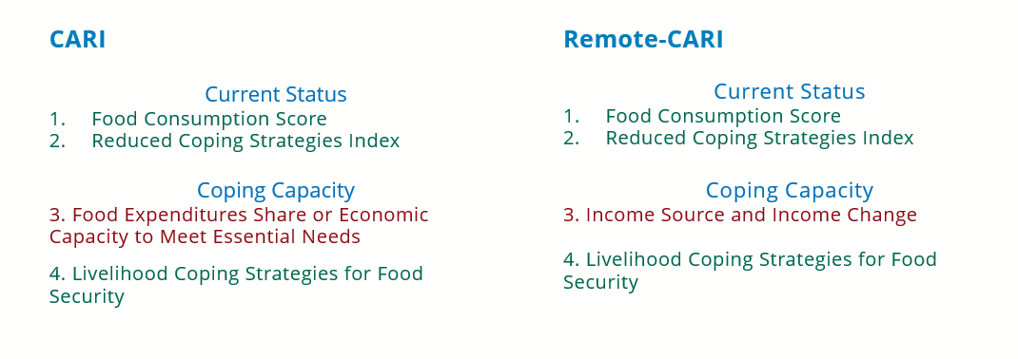
Background
rCARI collects data through phone based or CATI interviews
rCARI aggregates indicators like standard CARI

Slide 4
Background
There are different possible ways to calculate rCARI
Which method is comparable to CARI
Income sources and change,
short expenditure module??
rCARI not empirically validated against CARI
Short expenditure module not tested against standardized ones
Notes:
Used the available indicators and created rCSI gender-sensitive
Sampled at HH level and interviewed 2 members in each HH (male and female)
We got money from Gender, we had time before the official start of the rCARI study

Slide 5
Research questions
How does the different versions of rCARI compare with CARI v3?
rCARI from F2F & Remote
What is the diagnostic accuracy of the different versions of CARI/rCARI?
CARI v3 FES-long
CARI v3 FES-short
How does interview modality affect AFI reporting?
Intra-household comparison AFI reporting
Remote-first compared with F2F-first interviews

Slide 6
Iraq pilot sample design
1st Interview
Follow-up interview
Group A (Phone)
375 HH
Group A
(F2F)
300 HH
Max interval 48 Hrs
Sampled HH
(600 + 25% attrition)
Group B
(F2F)
375 HH
Group B (Phone)
300 HH
Max intervals 48 Hrs

Slide 7
Iraq pilot sample design
1st Interview
Follow-up interview
Group A (Phone)
375 HH
Group A (F2F) 300
Max interval 48 Hrs
150 HH Long-modules
Sampled HH
(600 + 25% attrition)
150 HH Short Modules
Group B (F2F) 375
188 HH Long-modules
Group B (Phone)
300 HH
Max intervals 48 Hrs
187 HH Short Modules

Slide 8
Implementation
Implemented as a cross-over design [2 groups of HH from the same sample]
We Sampled 571 households from 2 IDP and 2 refugee camps
Each household was interviewed twice
Face-to-face
Remote
This would allow for intra- and inter-household validation of the measurements

Slide 9
Limitation of the Iraq Study
Difficulty in getting the exact same respondent within the household to be interviewed in both modalities
High drop-out rates between modalities (attrition high)
Most respondents refused the second interview after the first
Some HHs provided wrong phone contacts for remote follow-up
Remote first HHs deliberately avoided the agreed time to visit for the F2F interviews

Slide 10
Final interviewed HHs
Only F2F
136 HH
Total F2F
590 HH
Total Sample
676 HH
Completed
454 HH
Only Remote
86 HH
Total Remote
540 HH
In two interviews
187 HH have age difference over 2 yrs
178 HH have respondents of different Household Head status (firstly indicated as Head and in follow up changed to not Head)
176 HH have respondents of different sex
138 HH have exact the same sex, age, household head status
Enforce to find the same respondent -> Higher attrition

Slide 11
Limitation of the Iraq Study
Long over-lap between first and second interview
Increase data collection time
Confounding from aliasing/carryover effects - pre exposure effect
Not possible to implement “wash-out period” between first and second interviews-Indicators should cover the same reporting period
High number of households participating in only one modality i.e., face to face interview only or remote interview only

Slide 12
How does the different versions of rCARI compare with CARI v3?

Slide 13
rCARI from remote versus CARI v3 F2F
 | F2F Answer | Remote Answer | Difference | P Value
FCS | 62.22 | 56.00 | 6.22 | 0.00
rCSI | 14.74 | 14.15 | 0.59 | 0.43
Used Stress-Level Coping | 0.89 | 0.89 | -0.00 | 0.82
Used Crisis-Level Coping | 0.69 | 0.62 | 0.08 | 0.01
Used Emergency-Level Coping | 0.08 | 0.28 | -0.19 | 0.00
HHExpFood | 307827.17 | 450377.60 | -142550.43 | 0.00
HHExpNF | 344632.66 | 264484.03 | 80148.63 | 0.00
HHExpTotal | 652459.82 | 714861.63 | -62401.81 | 0.06
PCExpTotal | 126286.60 | 139006.74 | -12720.14 | 0.08
FES | 50.20 | 64.00 | -13.81 | 0.00
Vulnerability (3 & 4) | 0.24 | 0.55 | -0.31 | 0.00

Slide 14
rCARI from F2F versus CARI v3 F2F

Slide 15
rCARI from remote versus CARI v3 F2F

Slide 16
CARI vs. rCARI Intra-HH Outcome Comparison
[Full Completes n = 454]
Variable | F2F | Remote | Difference | P-Value
FCS | 62.22 | 56.00 | 6.22 | 0.00
rCSI | 14.74 | 14.15 | 0.59 | 0.43
Used Stress-Level Coping | 0.89 | 0.89 | -0.00 | 0.82
Used Crisis-Level Coping | 0.69 | 0.62 | 0.08 | 0.01
Used Emergency-Level Coping | 0.08 | 0.28 | -0.19 | 0.00
HHExpFood | 307827.17 | 450377.60 | -142550.43 | 0.00
HHExpNF | 344632.66 | 264484.03 | 80148.63 | 0.00
HHExpTotal | 652459.82 | 714861.63 | -62401.81 | 0.06
PCExpTotal | 126286.60 | 139006.74 | -12720.14 | 0.08
FES | 50.20 | 64.00 | -13.81 | 0.00
Vulnerability (3 & 4) | 0.24 | 0.55 | -0.31 | 0.00

